Slide 1



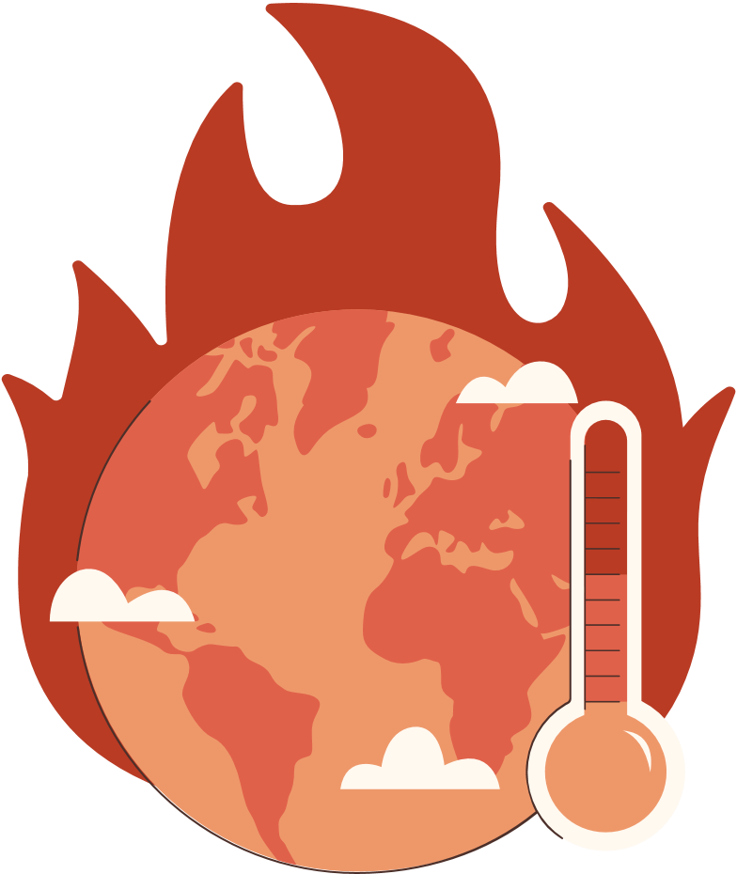
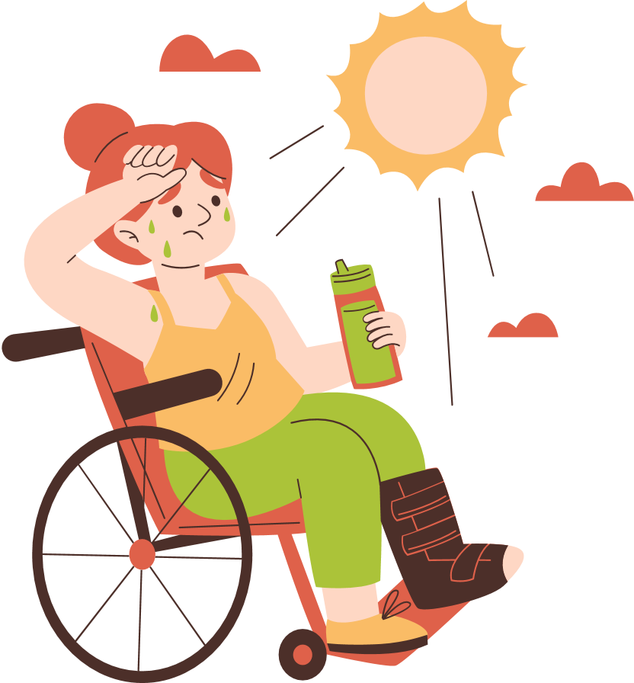
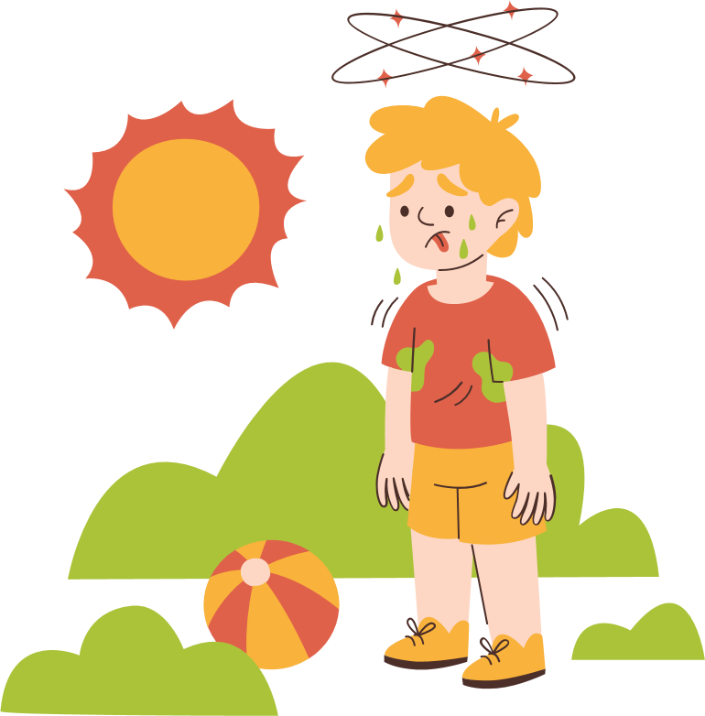
Biến đổi khí hậu
Understanding the Impacts and Taking Action

Slide 2







Let's discuss the impacts of climate change on our planet and the steps we can take to address them.

Slide 3


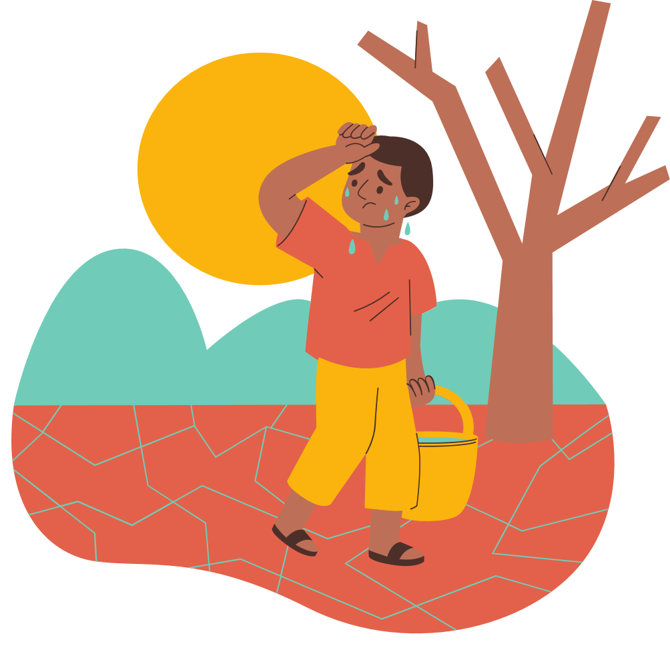



Table of Contents
What is Climate Change?
Causes of Climate Change
Environmental Impacts
Renewable Energy
Mitigation Strategy
Adaptation Strategy

Slide 4



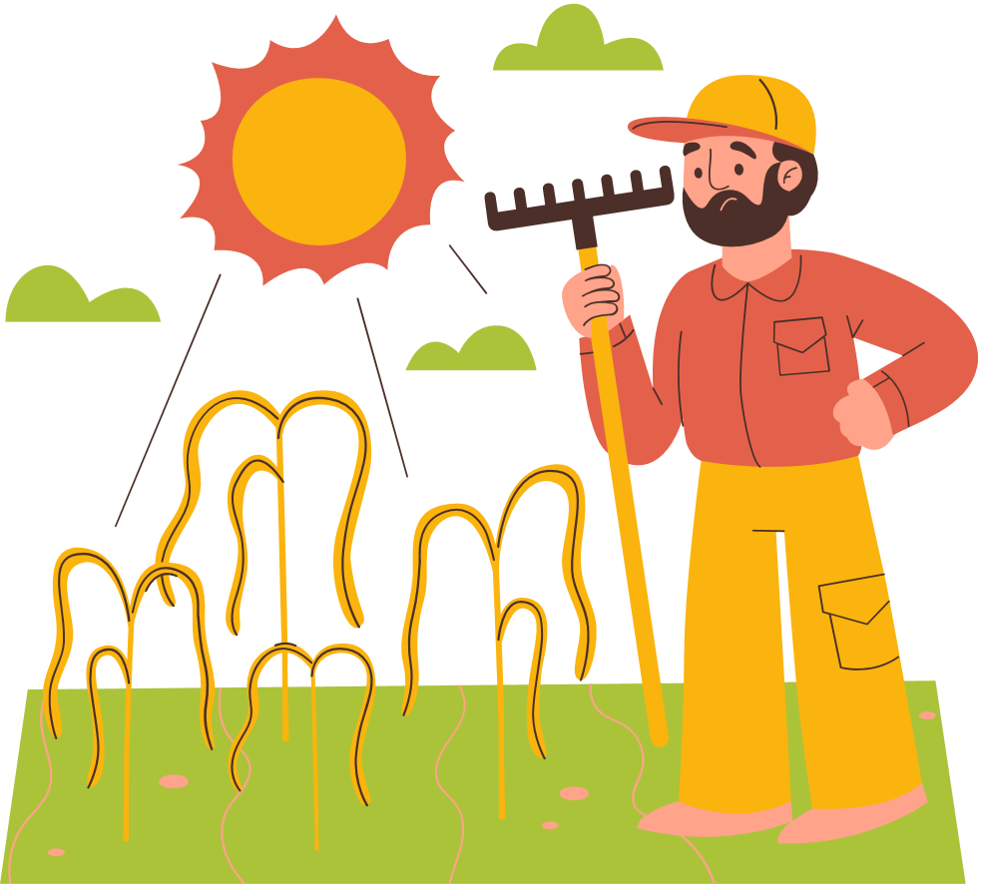

What is Climate Change?
Climate change refers to long term changes in temperature and weather patterns around the world. While these changes can occur naturally, human activities such as the burning of fossil fuels are accelerating this process significantly.

Slide 5



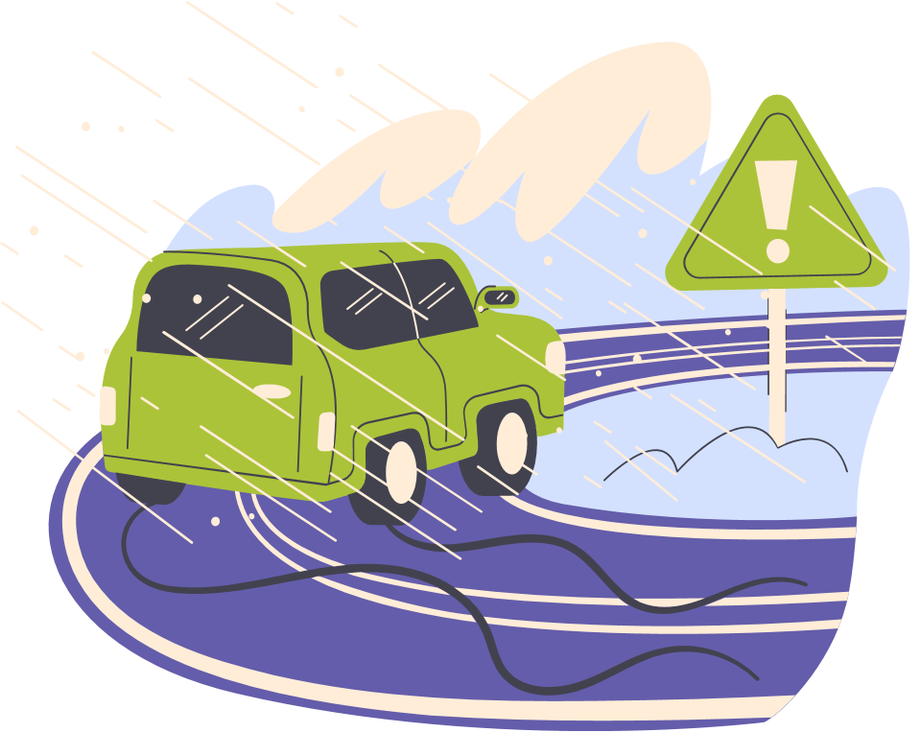





Environmental Impacts
Environmental impacts of climate change include rising global temperatures, melting polar ice caps, rising sea levels, and changing weather patterns.

Slide 6







Thank
you

